Slide 1
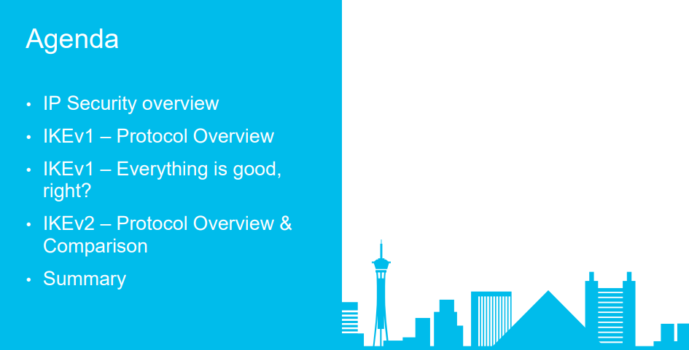

Slide 2
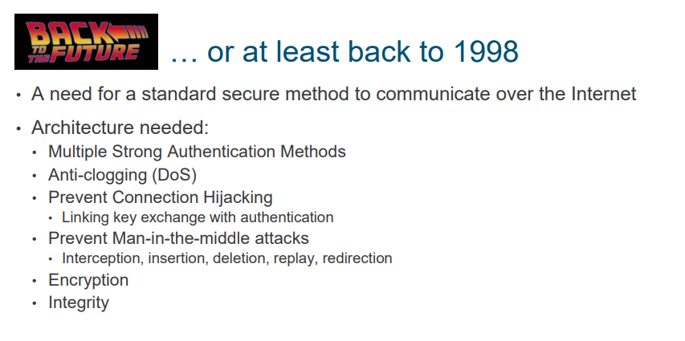

Slide 3
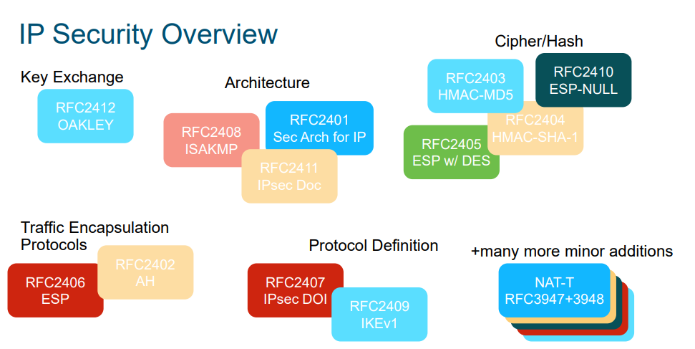

Slide 4
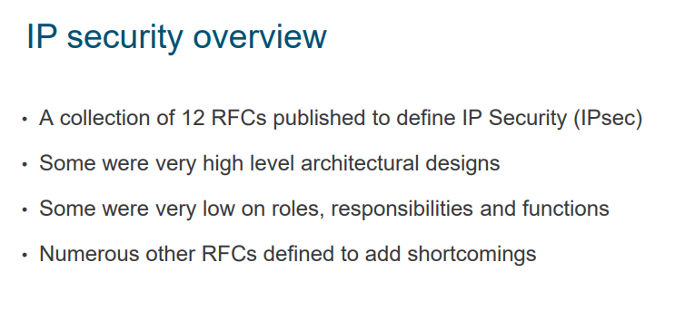

Slide 5
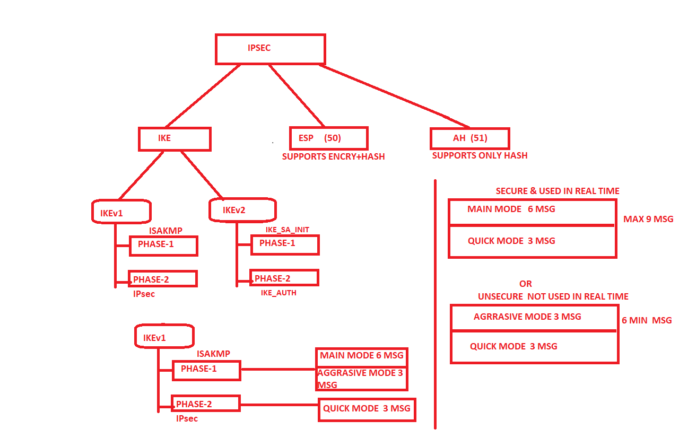

Slide 6
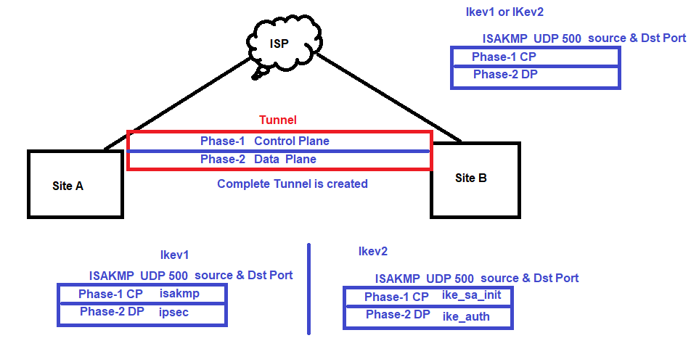
VPN

Slide 7
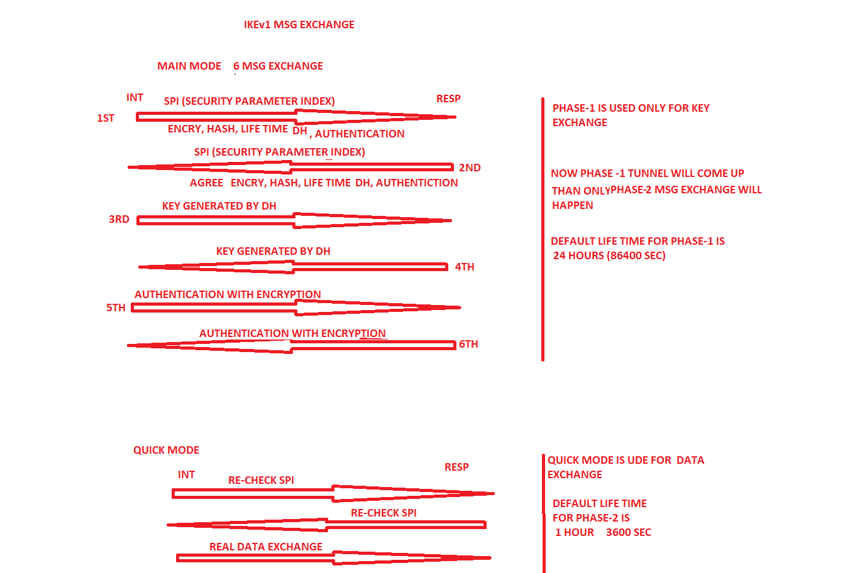

Slide 8
IPsec IKE Version 1 Message Exchange Internet Key Exchange (IKE) is a protocol used to set up a IPSec Security Associations (SAs) security attributes like encryption key, encryption algorithm, and mode, between IPSec peers. Internet Key Exchange allows IPSec peers to dynamically exchange keys and negotiate IPSec Security Associations (SAs). Using Internet Key Exchange (IKE), IPSec Security Associations (SAs) can be dynamically established and removed at a negotiated time period. Internet Key Exchange (IKE) is an IETF protocol and it has two versions, an old version IKEv1 (RFC 2409, RFC 4109) and a relatively new version, IKEv2 (RFC 5996, RFC 7296 and RFC 7427). Internet Key Exchange is a hybrid protocol made from Oakley, SKEME (A Versatile Secure Key Exchange Mechanism for Internet) and ISAKMP (Internet) Security Association and Key Management Protocol) protocols. ISAKMP protocol is a framework for exchanging encryption keys and security association payloads. IKE uses UDP, Port Number 500.
Internet Key Exchange Version 1 (IKEv1) The operation IKEv1 can be broken down into two phases. 1) Phase 1 (IKE SA Negotiation) and 2) Phase 2 (IPSec SA Negotiation). IKEv1 Phase 1 SA negotiation is for protecting IKE. IKEv1 Phase 2 SA negotiation is for protecting IPSec (real user traffic). IKEv1 Phase 1 negotiation can happen in two modes, either using Main Mode or using Aggressive Mode. IKEv1 Phase 1 Main mode has three pairs of messages (total six messages) between IPSec peers. IKE Phase 1 Aggressive Mode has only three message exchanges. The purpose of IKEv1 Phase 1 is to establish IKE SA. IKEv1 Phase 2 (Quick Mode) has only three messages. The purpose of IKEv1 Phase 2 is to establish IPSec SA. Phase 1 is used to negotiate the parameters and key material required to establish IKE Security Association (SA)between two IPSec peers. The Security Associations (SAs) negotiated in Phase 1 is then used to protect future IKE communication. Following explanation is based on the assumption that the peers are using PreShared Key for authentication.

Slide 9
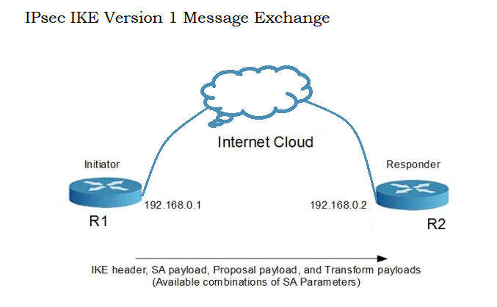
IKEV1> Main Mode> 1st msg exchange

Slide 10
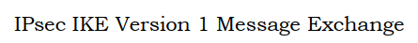
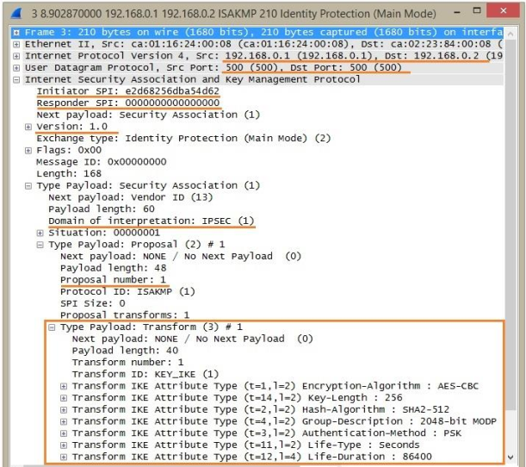
IKEV1> Main Mode> 1st msg exchange

Slide 11
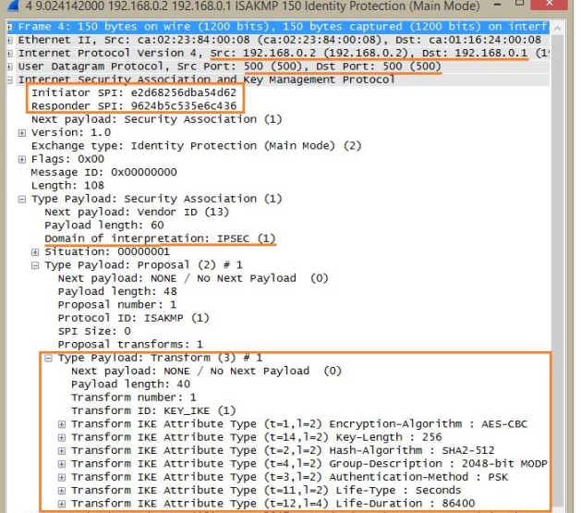
IKEv1 Phase 1 Main Mode - Message 2: IKEv1 Main Mode Message 2 is the response from the Responder to the packet sent from the initiator. The purpose of Message 2 is to inform Initiator the SA attributes agreed upon. Most of the fields are the same as in the packet sent by the initiator. Only one proposal payload and transform payload is there in Message 2, which is the agreed proposal and transform payload. Also note that both the cookie values are filled.

Slide 12
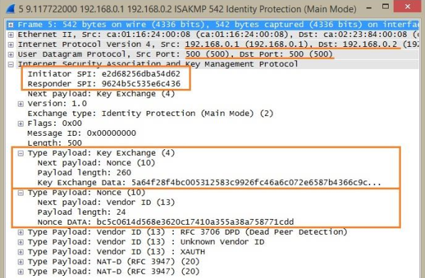
IKEv1 Phase 1 Main Mode - Message 3: The direction of third message is from the Initiator to the Responder. This message contains Diffie-Hellman Key Exchange Payload and Nonce payload & NAT-D payload from Initiator.

Slide 13
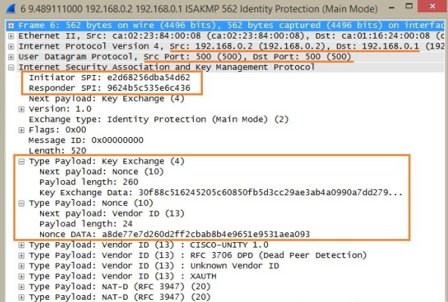
IKEv1 Phase 1 Main Mode - Message 4: The direction of third message is from the Responder to the Initiator. This message contains Diffie-Hellman Key. Exchange Payload and Nonce payload, from Responder. A Nonce is a very large random number used in IKE. IKE Nounce random number is also used to calculate keying material. Please note that the first four IKEv1 Phase 1 Main mode messages are not encrypted.

Slide 14
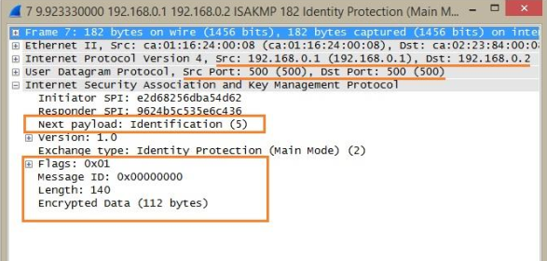
IKEv1 Phase 1 Main Mode - Message 5: Both IPSec peers calculate DiffieHellman shared secret. Three keys are generated by both peers for authentication and encryption. 5th message contains Identification payload and Hash Payload, from Initiator. Identification payload and Hash Payload are used for identitification and authentication. Identification payload and Hash Payload payloads are sent encrypted, in IKEv1 Phase 1 Main Mode.

Slide 15
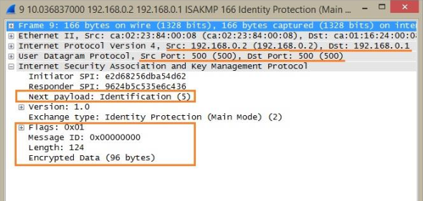
IKEv1 Phase 1 Main Mode - Message 6: 6th message contains Identification payload and Hash Payload. Identification payload and Hash Payload are used for identitification and authentication from Responder. Identification payload and Hash Payload payloads are sent encrypted in IKEv1 Phase 1 Main Mode.

Slide 16
Aggressive Mode

Slide 17
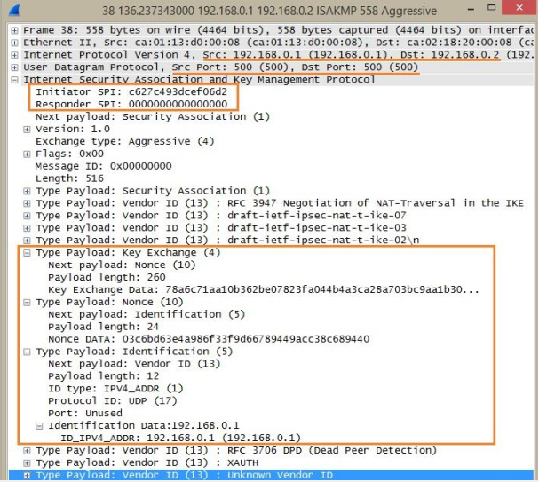
IPsec IKE Version 1 Message Exchange IKEv1 Phase 1 Aggressive Mode IKEv1 Phase 1, when in Aggressive mode, uses only three messages to establish IKE SA. The first two messages in Aggressive mode exchange include almost everything required to form IKE SA. IKEv1 Phase1 Aggressive Mode is quicker than Main Mode, but endpoint identities are exchanged in Clear-Text. When comparing Main Mode and Aggressive Mode, Main mode is considered more secure than Aggressive Mode, because the Identification payload is encrypted in Main Mode.
IKEv1 Phase 1 Aggressive Mode - Message 1: In IKEv1 Phase1 Aggressive Mode, all the necessary information required to generate the Diffie-Hellman shared secret is exchanged in the first two messages between peers. The first message sent from the Initiator includes SA payload, Proposal payload, and Transform payload, similar to Main Mode. The main difference in Aggressive Mode is that the first message includes Diffie-Hellman Key Exchange payload and the Nonce payload. Identification payload is also added in the first message. Note that the Identification payload is sent as Clear-Text, not encrypted.

Slide 18
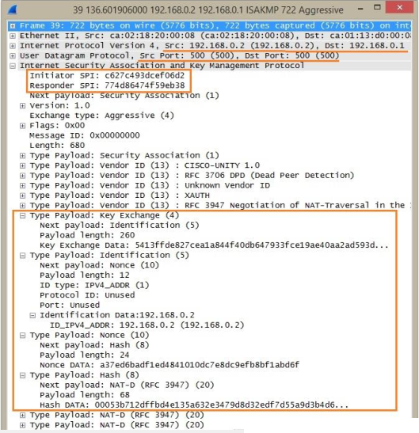
IKEv1 Phase 1 Aggressive Mode - Message 2: Now the Responder can generate the Diffie-Hellman shared secret. The Responder generates the Diffie-Hellman shared secret. Responder generates the Hash also for Authentication purposes. Similar to Message 2 in IKEv1 Phase1 Main Mode, Message 2 in IKEv1 Phase1 Aggressive Mode also contains the agreed proposal and transform pair from the Responder. It also contains Key Exchange Payload, Nounce Payload, Identity Payload and an Authentication Hash from the Responder.

Slide 19
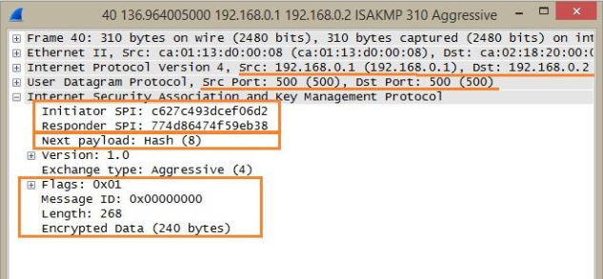
IKEv1 Phase 1 Aggressive Mode - Message 3: Now the Initiator can generate the Diffie-Hellman shared secret. The Initiator generates the Diffie-Hellman shared secret. Initiator generates the Hash also for Authentication purposes. The Hash payload is sent as encrypted.

Slide 20
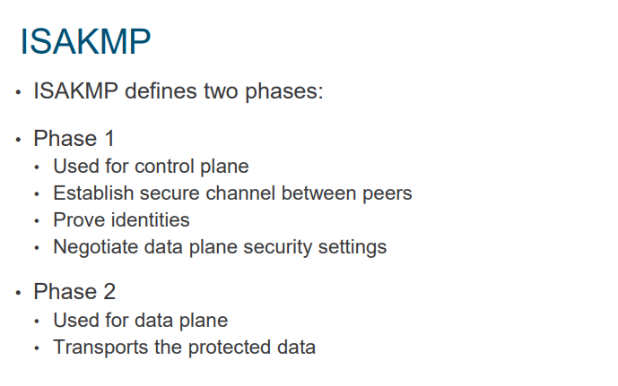
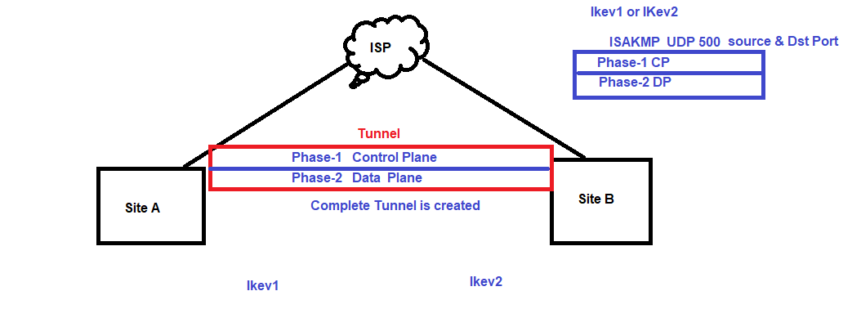

Slide 21
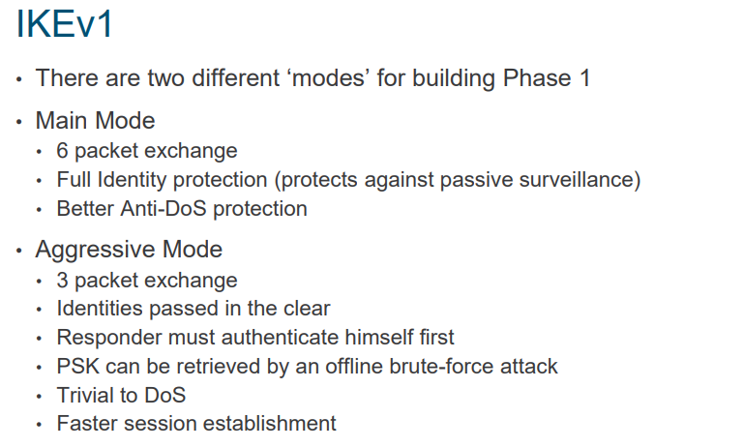

Slide 22
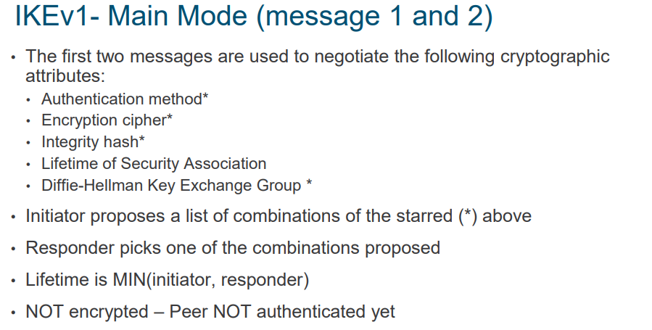

Slide 23
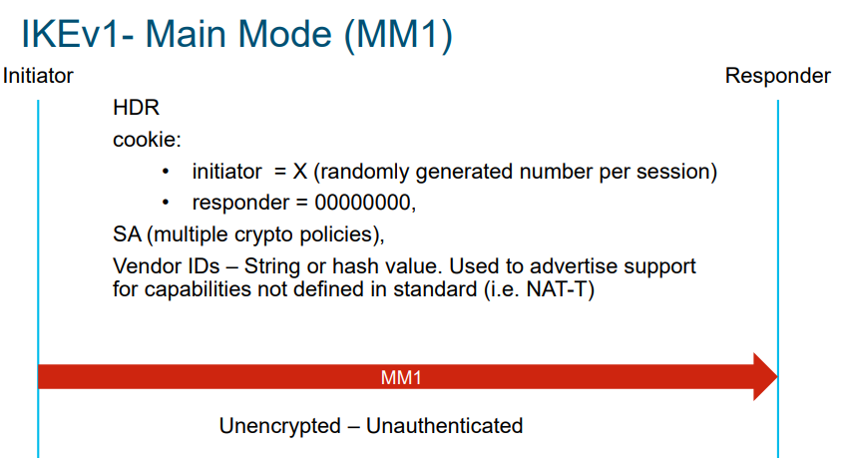
The following notation is used throughout this memo.
HDR is an ISAKMP header whose exchange type is the mode. When written as HDR* it indicates payload encryption
SA is an SA negotiation payload with one or more proposals. An initiator MAY provide multiple proposals for negotiation; a responder MUST reply with only one

Slide 24
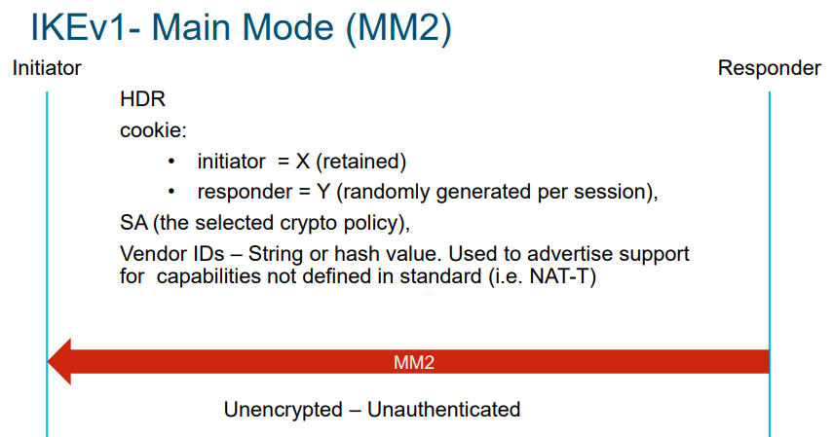

Slide 25
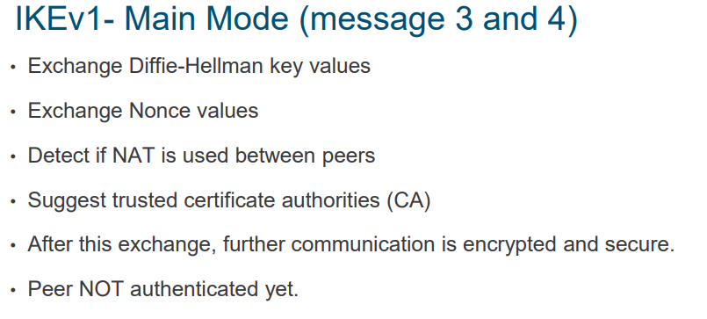

Slide 26
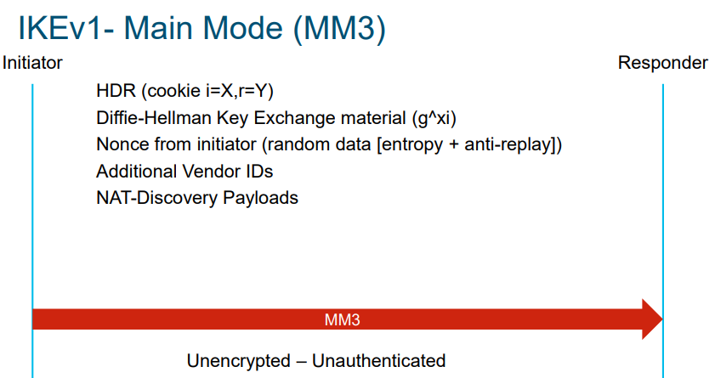

Slide 27
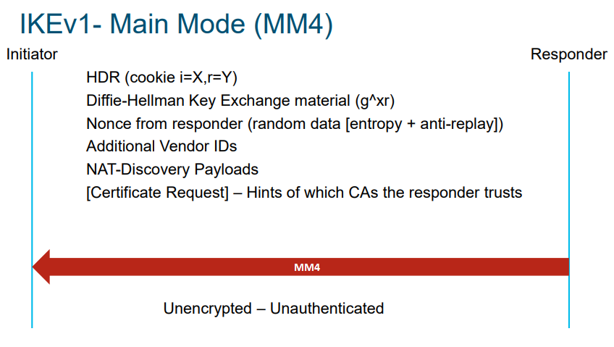

Slide 28
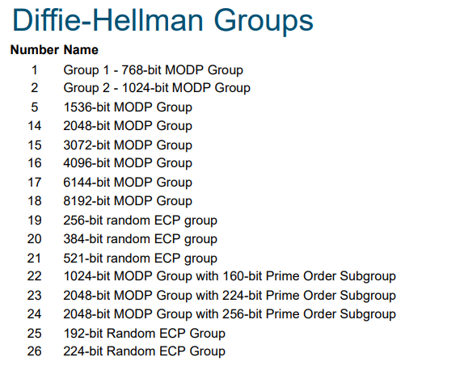

Slide 29
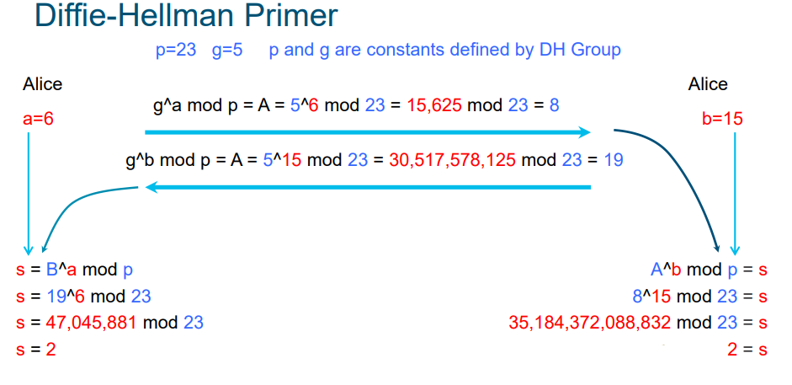

Slide 30
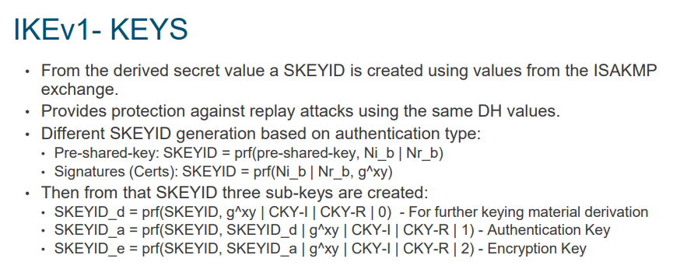

Slide 31
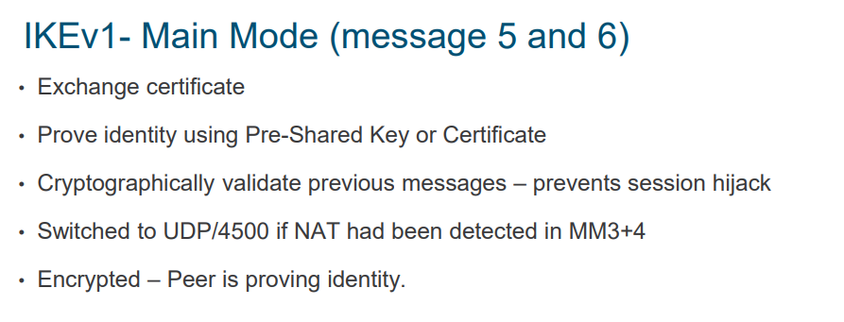

Slide 32
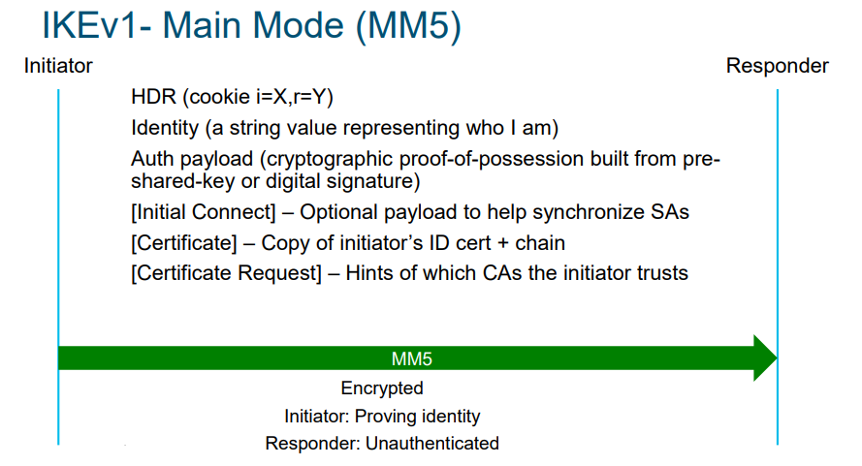

Slide 33
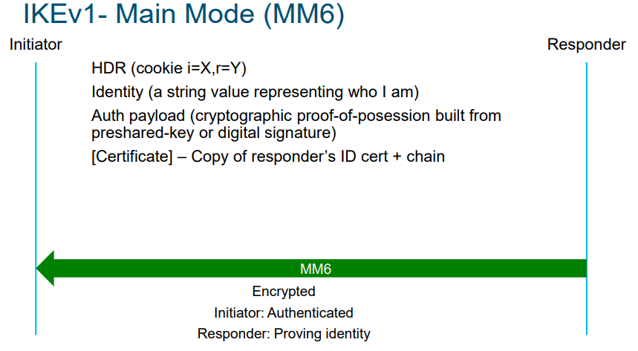

Slide 34
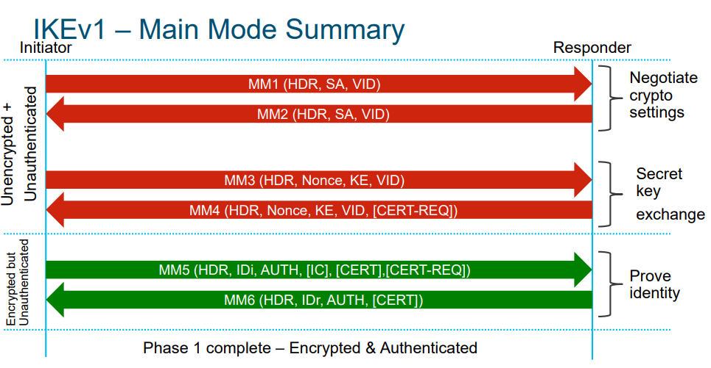

Slide 36
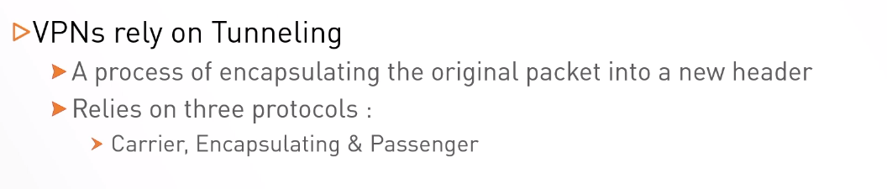
Public IP (Carrier)
GER/ESP(Encapsulating)
Private ip(Passenger)

Slide 37
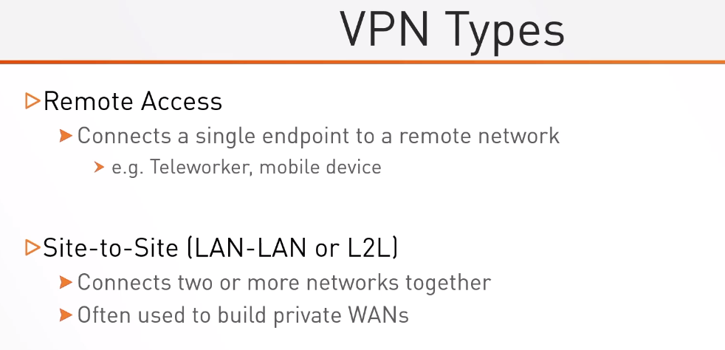

Slide 38
